Slide 1

BACHELOR OF TECHNOLOGY
IN
Artificial Intelligence and Machine Learning
(MR20-1CS0134)- Deep Learning Explore
III Year – II Semester
Project Guide: Dr. G. GIFTA JERITH
Department of AIML, School of Engineering
Malla Reddy University Hyderabad.
Batch Number: ST11
Batch Names and Roll Numbers:
2111cs020407-P.Rohan 2111cs020409-A.Rohith Kumar
2111cs020411-K.Rupa Sri
2111cs020412-Rushi Eshwer Reddy Neelam
2111cs020413-D.Rushika

Slide 2
Introduction:
Project Title
Volume and Brightness Control By Hand Gestures Using Open CV And Media pipe
Problem Definition
In today's digital age, the interaction between humans and computers has evolved significantly. While traditional input devices like keyboards and mice are widely used, there is a growing demand for more intuitive and hands-free control methods. The aim of this project is to develop a Hand Gesture Volume and Brightness Control System using computer vision techniques and machine learning algorithms.
Objectives:
Gesture Recognition
Volume Control
Brightness Control
Real-time Operation
User-Friendly Interface

Slide 3
Analysis:
Project planning and research:
Exploration of existing technologies and methodologies.
Reviewing academic papers, articles, and online resources.
Identifying the challenges and opportunities.
Defining project objectives.
Investigating available software libraries and frameworks.
Software Requirement Specification
Software requirement
OpenCV tkninter
MediaPipe PIL (Python Imaging Library)
Screen_brightness_control Math
pycaw numpy

Slide 4
Hardware requirement:
Multi-core processor with a clock speed of at least 2.5 GHz.
8GB RAM minimum (16GB recommended).
SSD storage for faster data access.
Optional dedicated GPU with CUDA support for accelerated processing.
Adequate cooling and ventilation to prevent overheating.
Model Selection and Architecture:
MediaPipe Hand Tracking Model Parameters:
static_image_mode=False min_tracking_confidence=0.75
model_complexity=1 max_num_hands=2
min_detection_confidence=0.75

Slide 5
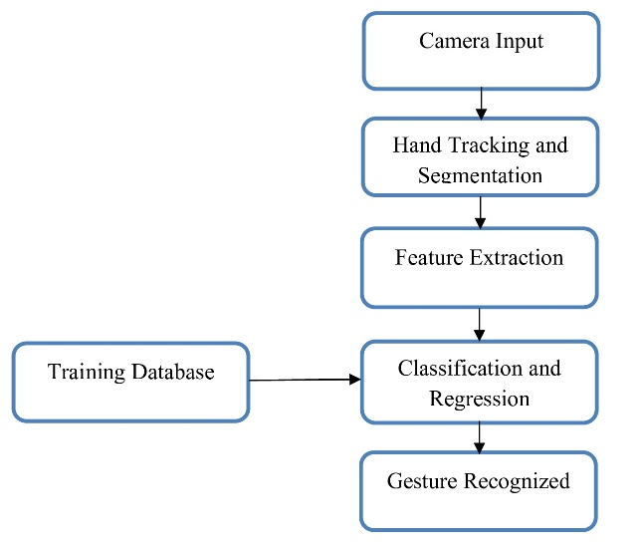
Architecture:

Slide 6
Design:
Introduction:
The design phase of the Hand Gesture Control project encompasses the conceptualization and structuring of the system's architecture, user interface, and functional components. This phase aims to translate the project requirements and objectives into a well-defined design framework, ensuring efficient implementation and seamless user interaction.
Data Preprocessing Techniques:
Image Resizing
Color Conversion
Normalization
Noise Reduction
ROI (Region of Interest) Extraction
Data Augmentation (Optional)

Slide 7
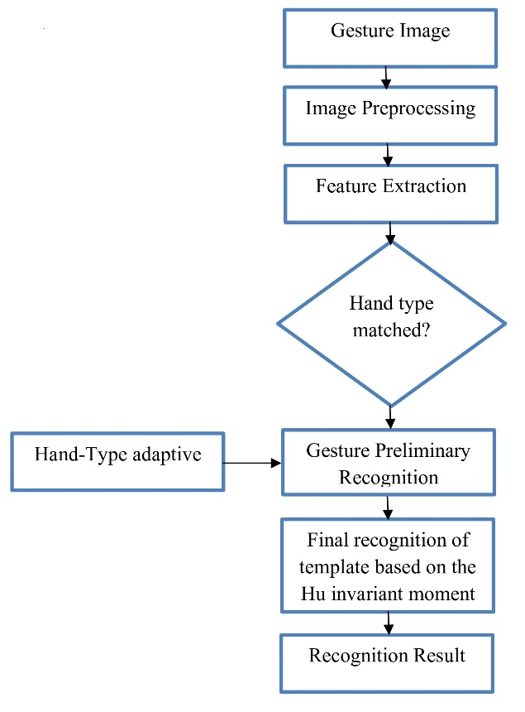
DFD/ER/UML diagram:

Slide 8
Data Set Description:
Dataset Name | Source | Size | Characteristics
Hand Landmarks | Custom | 10,000 frames | Annotated video frames with hand landmarks
Background Images | Open Source | 500 images | Various backgrounds for gesture recognition
Control Gestures | Recorded | 100 gestures | Recorded gestures for volume and brightness
Noise Samples | Generated | 50 samples | Synthetic noise samples for data augmentation

Slide 9
Methods & Algorithms:
Gesture Recognition
Landmark Detection
Gesture Classification
Hand Tracking and Pose Estimation
Convolutional Neural Networks (CNNs)
Volume Control
Mapping Gestures to Volume Levels
Brightness Adjustment
Numerical Computation and Data Processing

Slide 10
DEPLOYMENT AND RESULTS:
Introduction:
The deployment phase marks the culmination of the Hand Gesture Control project, involving the deployment of the system and the analysis of its performance and outcomes. This section covers the deployment process and highlights the key results and achievements of the project.

Slide 11
Model Implementation and Training:
The Hand Gesture Control system utilizes the MediaPipe Hand Tracking model for hand landmark detection and tracking within webcam frames.
The MediaPipe Hand Tracking model is integrated into the Python environment, leveraging the MediaPipe library for seamless model implementation.
The MediaPipe model does not require traditional training as it comes pre-trained on hand landmark data.
Model optimization techniques such as pruning, quantization, and model simplification may be applied to reduce computational overhead and improve inference speed.
Model evaluation metrics such as detection accuracy, tracking stability, computational efficiency, and latency are measured and analyzed.
Performance results are analyzed and compared against predefined benchmarks and user expectations.
Continuous monitoring and updates ensure that the Hand Gesture Control system remains responsive, accurate, and adaptable to user interactions and environmental changes.

Slide 12
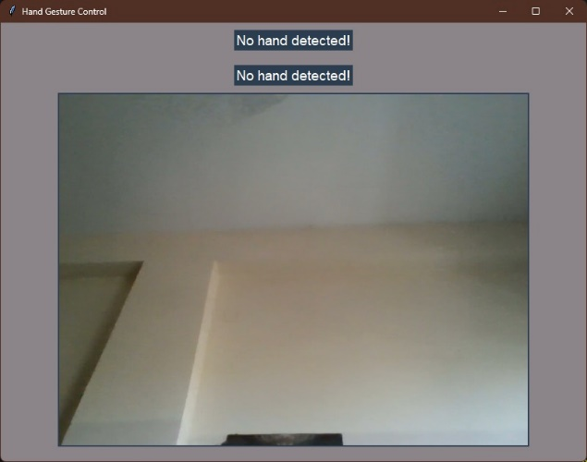
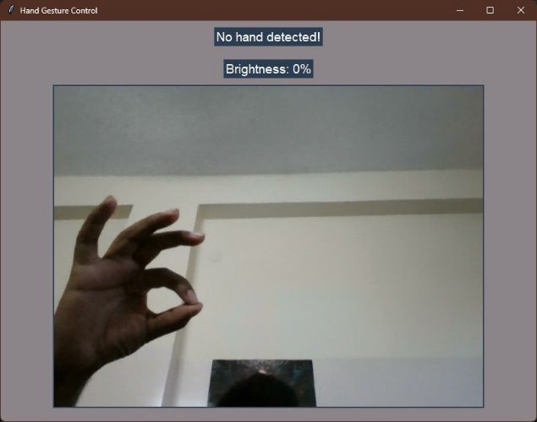
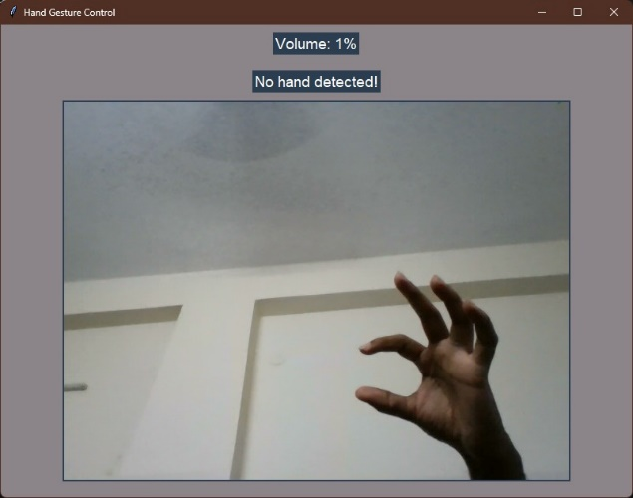
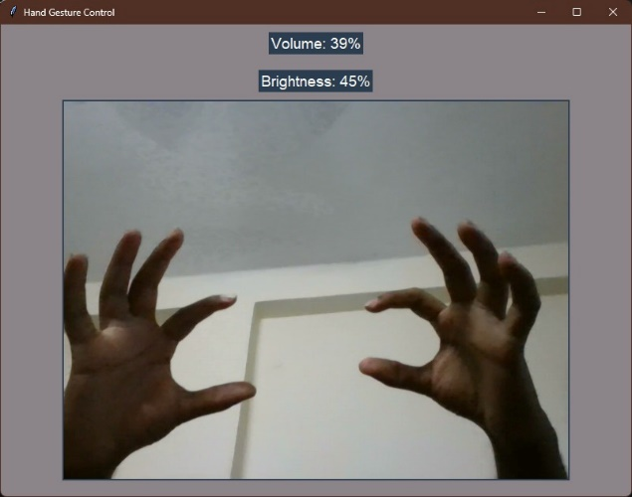
Output Screen:

Slide 13
Conclusion:
Project conclusion:
The project introduces a gesture-based volume and brightness controller that enables users to conveniently control software through hand gestures. Unlike systems requiring specific markers, this program operates with low-cost cameras on personal computers, eliminating the need for high-definition cameras. The system tracks the tip positions of the index and thumb fingers of each hand, aiming to automate and simplify system control. By utilizing this application, the system becomes more reliable and easier to control, aligning with the overarching goal of streamlining user interactions with software.
Future Scope:
Advanced Gesture Recognition
Multi-Modal Interaction
Machine Learning Improvements
Accessibility Features
Integration with Smart Systems

Slide 14
References:
[1.] RESEARCH GATE, GOOGLE .
[2.] C. L. NEHANIV. K J DAUTENHAHN M KUBACKI M. HAEGELEC. PARLITZ
[3.] R. ALAMI "A methodological approach relating the classification of gesture to identification of human intent in the context of human-robot interaction”, 371-377 2005.
[4.] M. KRUEGER Artificial reality II Addison-Wesley Reading (Ma)1991.
[5.] H.A JALAB "Static hand Gesture recognition for human computer interaction”, 1-72012. 4) JC.MANRESARVARONAR. MASF.
[6.] PERALES"Hand tracking and gesture recognition for human-computer interaction",2005
[7.] Intel Corp, “OpenCV Wiki,” OpenCV Library [Online], Available: http://opencv.willowgarage.com/wiki
[8.] Z. Zhang, Y. Wu, Y. Shan, S. Shafer. Visual panel: Virtual mouse keyboard and 3d controller with an ordinary piece of paper. In Proceedings of Perceptual User Interfaces, 2001

Slide 15
THANK YOU

